Slide 1
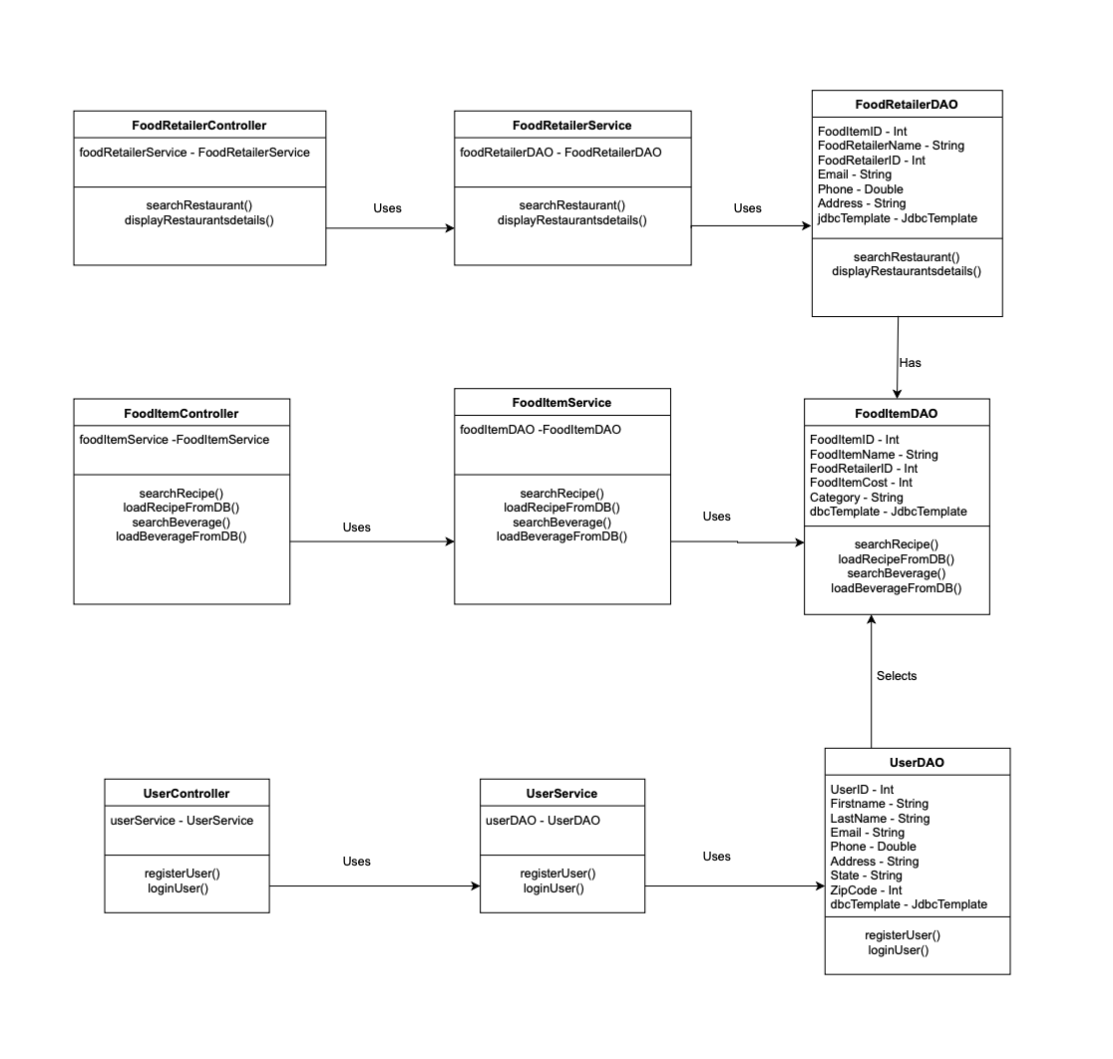
Class Diagram-Food Express

